Slide 1
An Investigation into Extending a 3D Cross Section of 4D Geometry and their Effectiveness in Teaching Users to Manipulating This Geometry
Joe Subbiani

Slide 2
Presentation Structure
What is the Fourth Dimension?
How to view the Fourth Dimension? – The 3D cross section.
Building 4D Shapes.
4D Rotation.
Extensions to the 3D cross section.
The Experiment.
The Results.

Slide 3
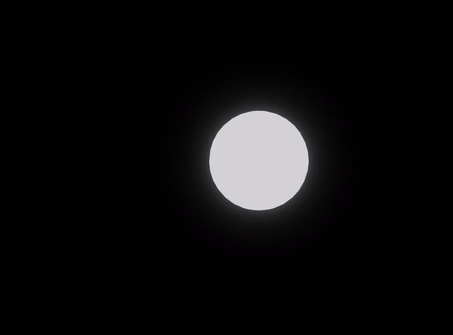
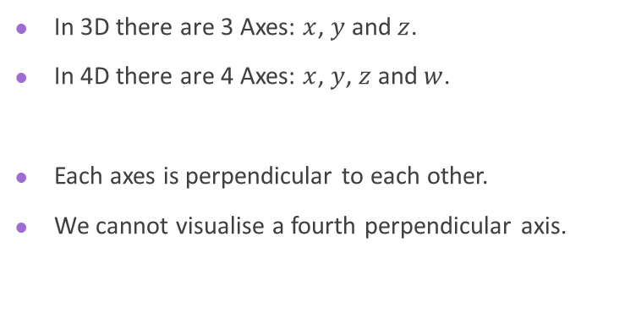
What is the 4th Dimension Structure
In 3D there are 3 Axes: $x$, $y$ and $z$.
In 4D there are 4 Axes: $x$, $y$, $z$ and $w$.
Each axes is perpendicular to each other.
We cannot visualise a fourth perpendicular axis.

Slide 4
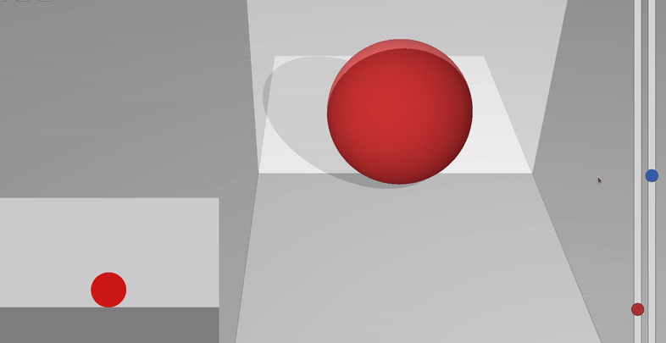
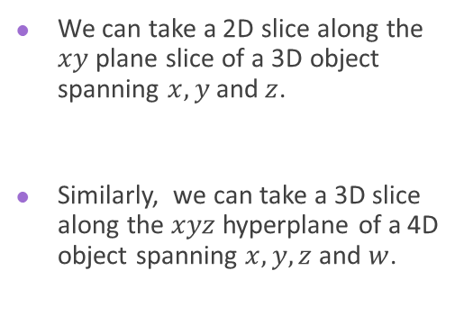
Taking A 3D Cross Section
How to view the 4th Dimension
We can take a 2D slice along the $xy$ plane slice of a 3D object spanning $x,y$ and $z$.
Similarly, we can take a 3D slice along the $xyz$ hyperplane of a 4D object spanning $x,y,z$ and $w$.

Slide 5
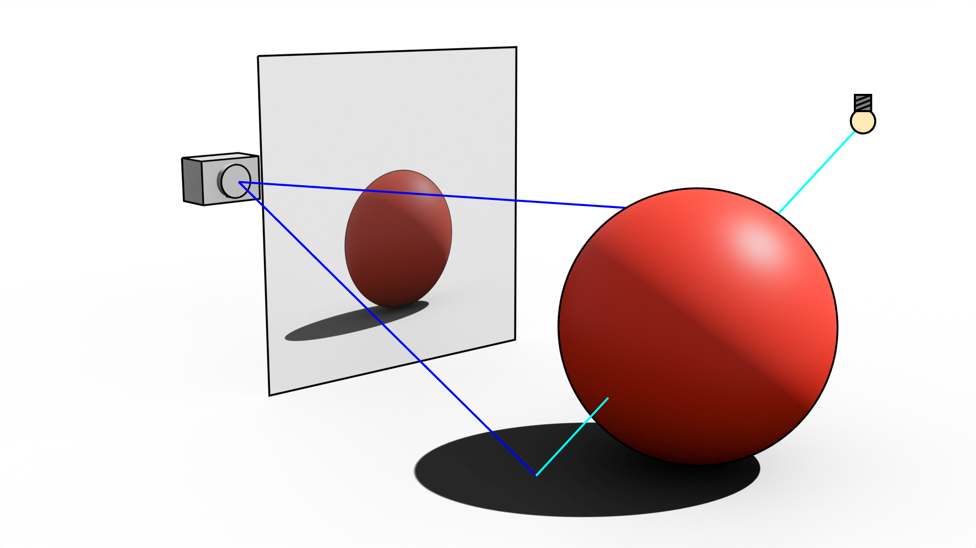
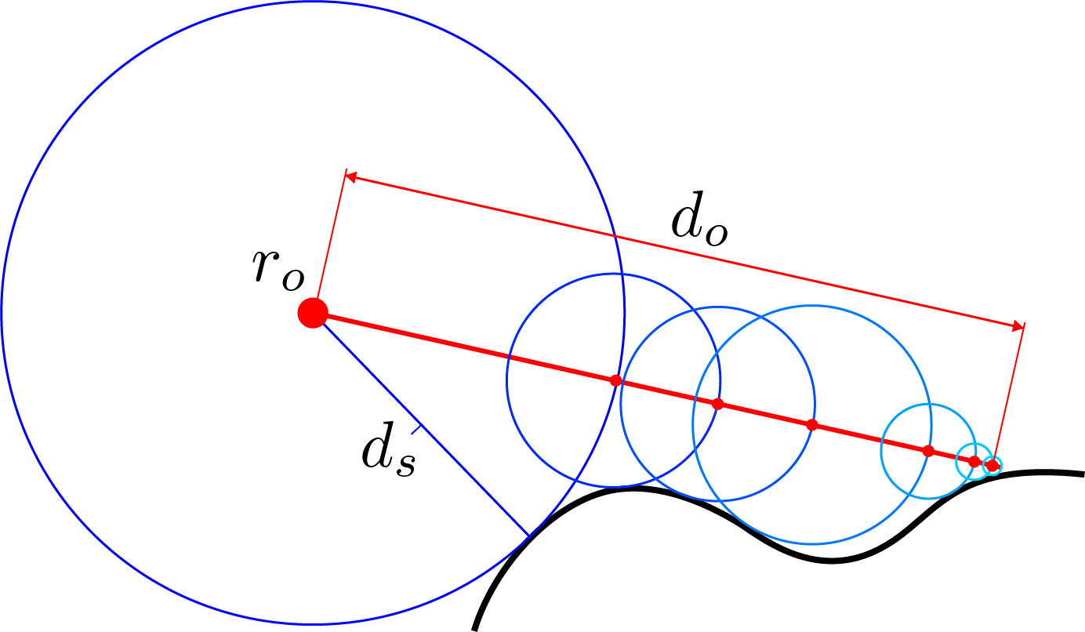
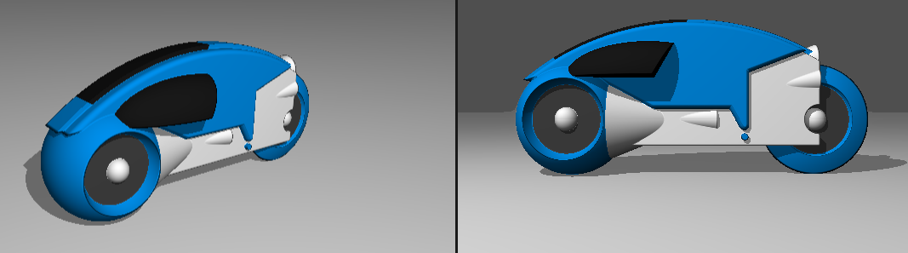
Ray Marching
Building 4D Shapes
Fun Fact: The original Tron used Ray Marching!

Slide 6
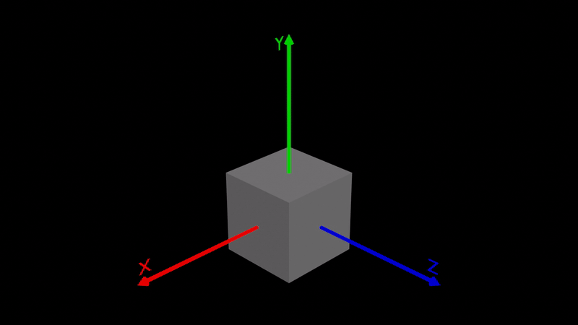
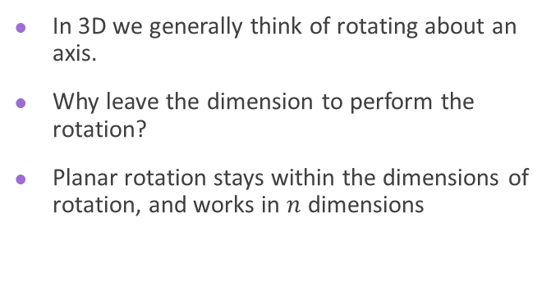
Rotating About a Plane
4D Rotation
In 3D we generally think of rotating about an axis.
Why leave the dimension to perform the rotation?
Planar rotation stays within the dimensions of rotation, and works in $n$ dimensions

Slide 7
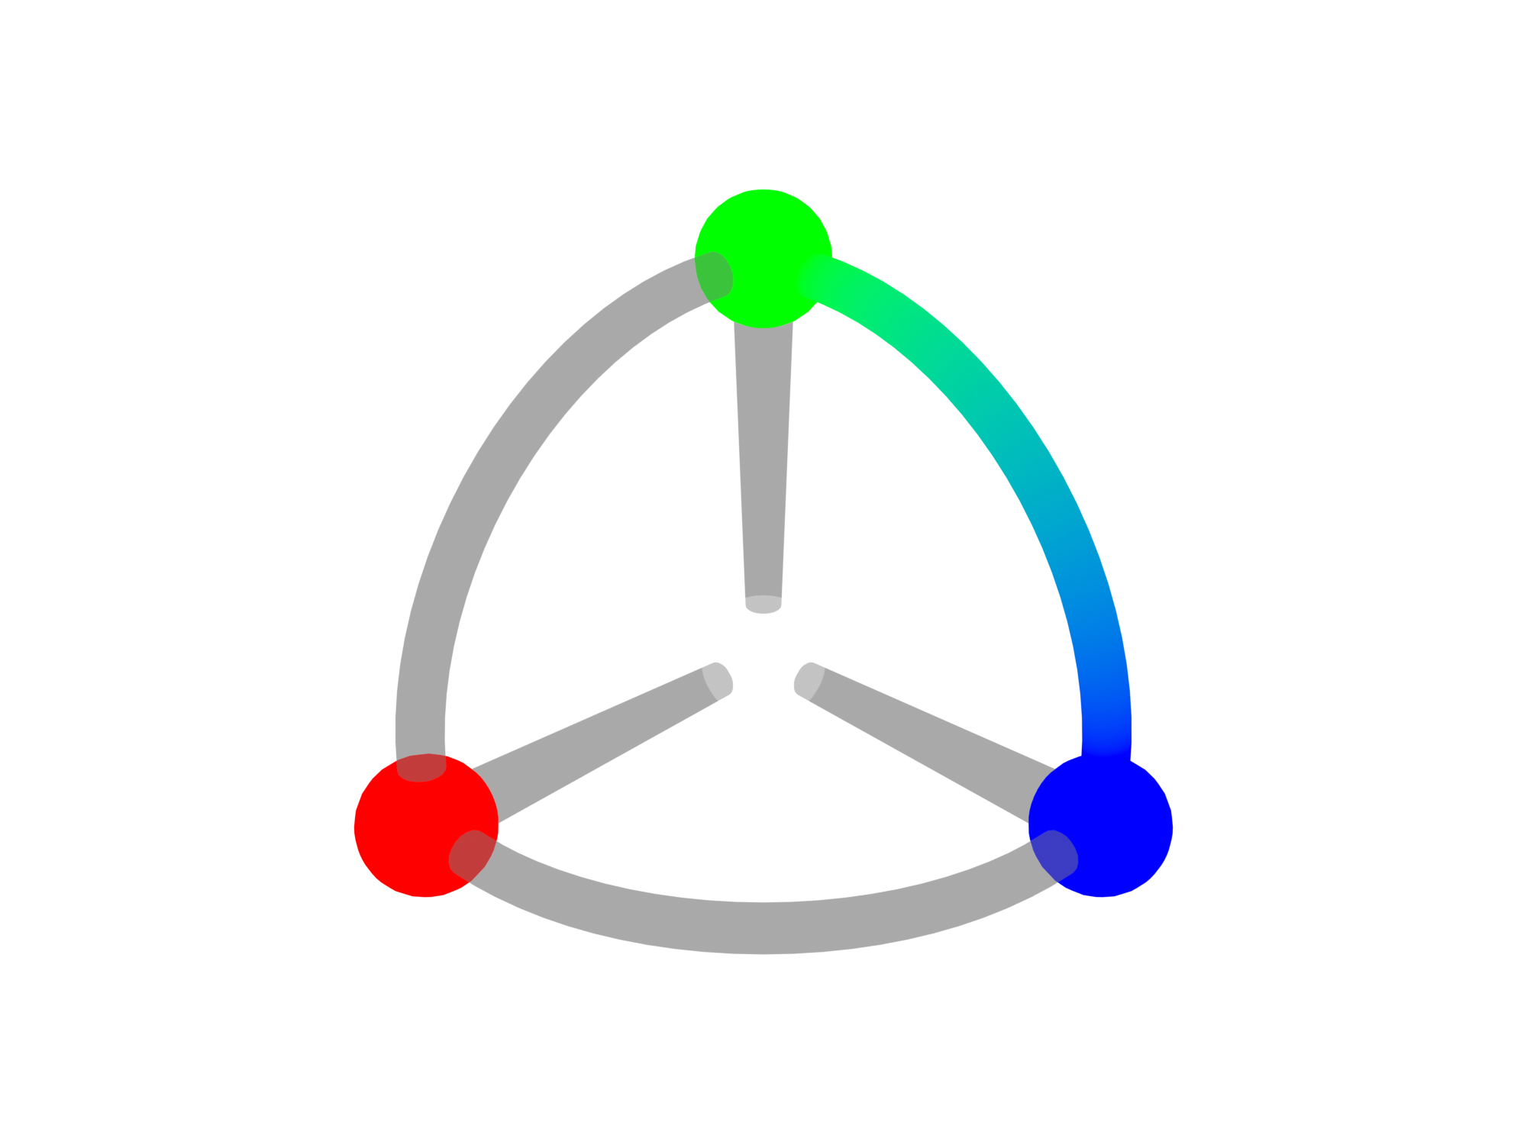
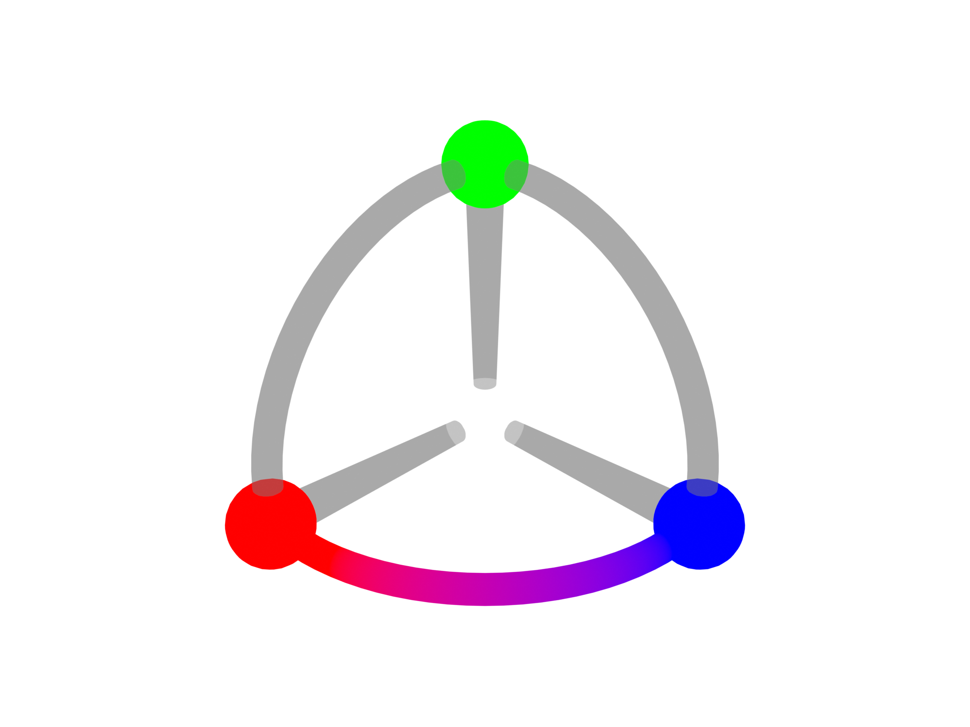
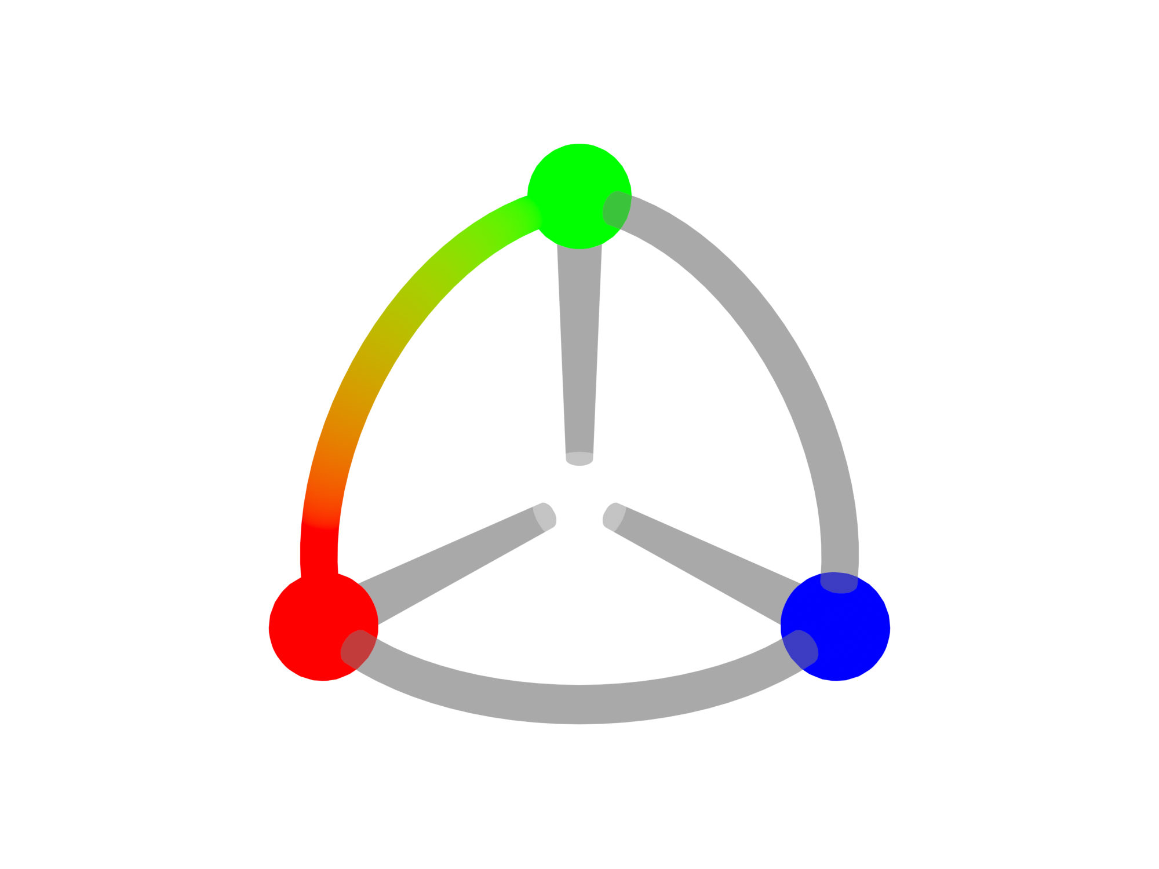
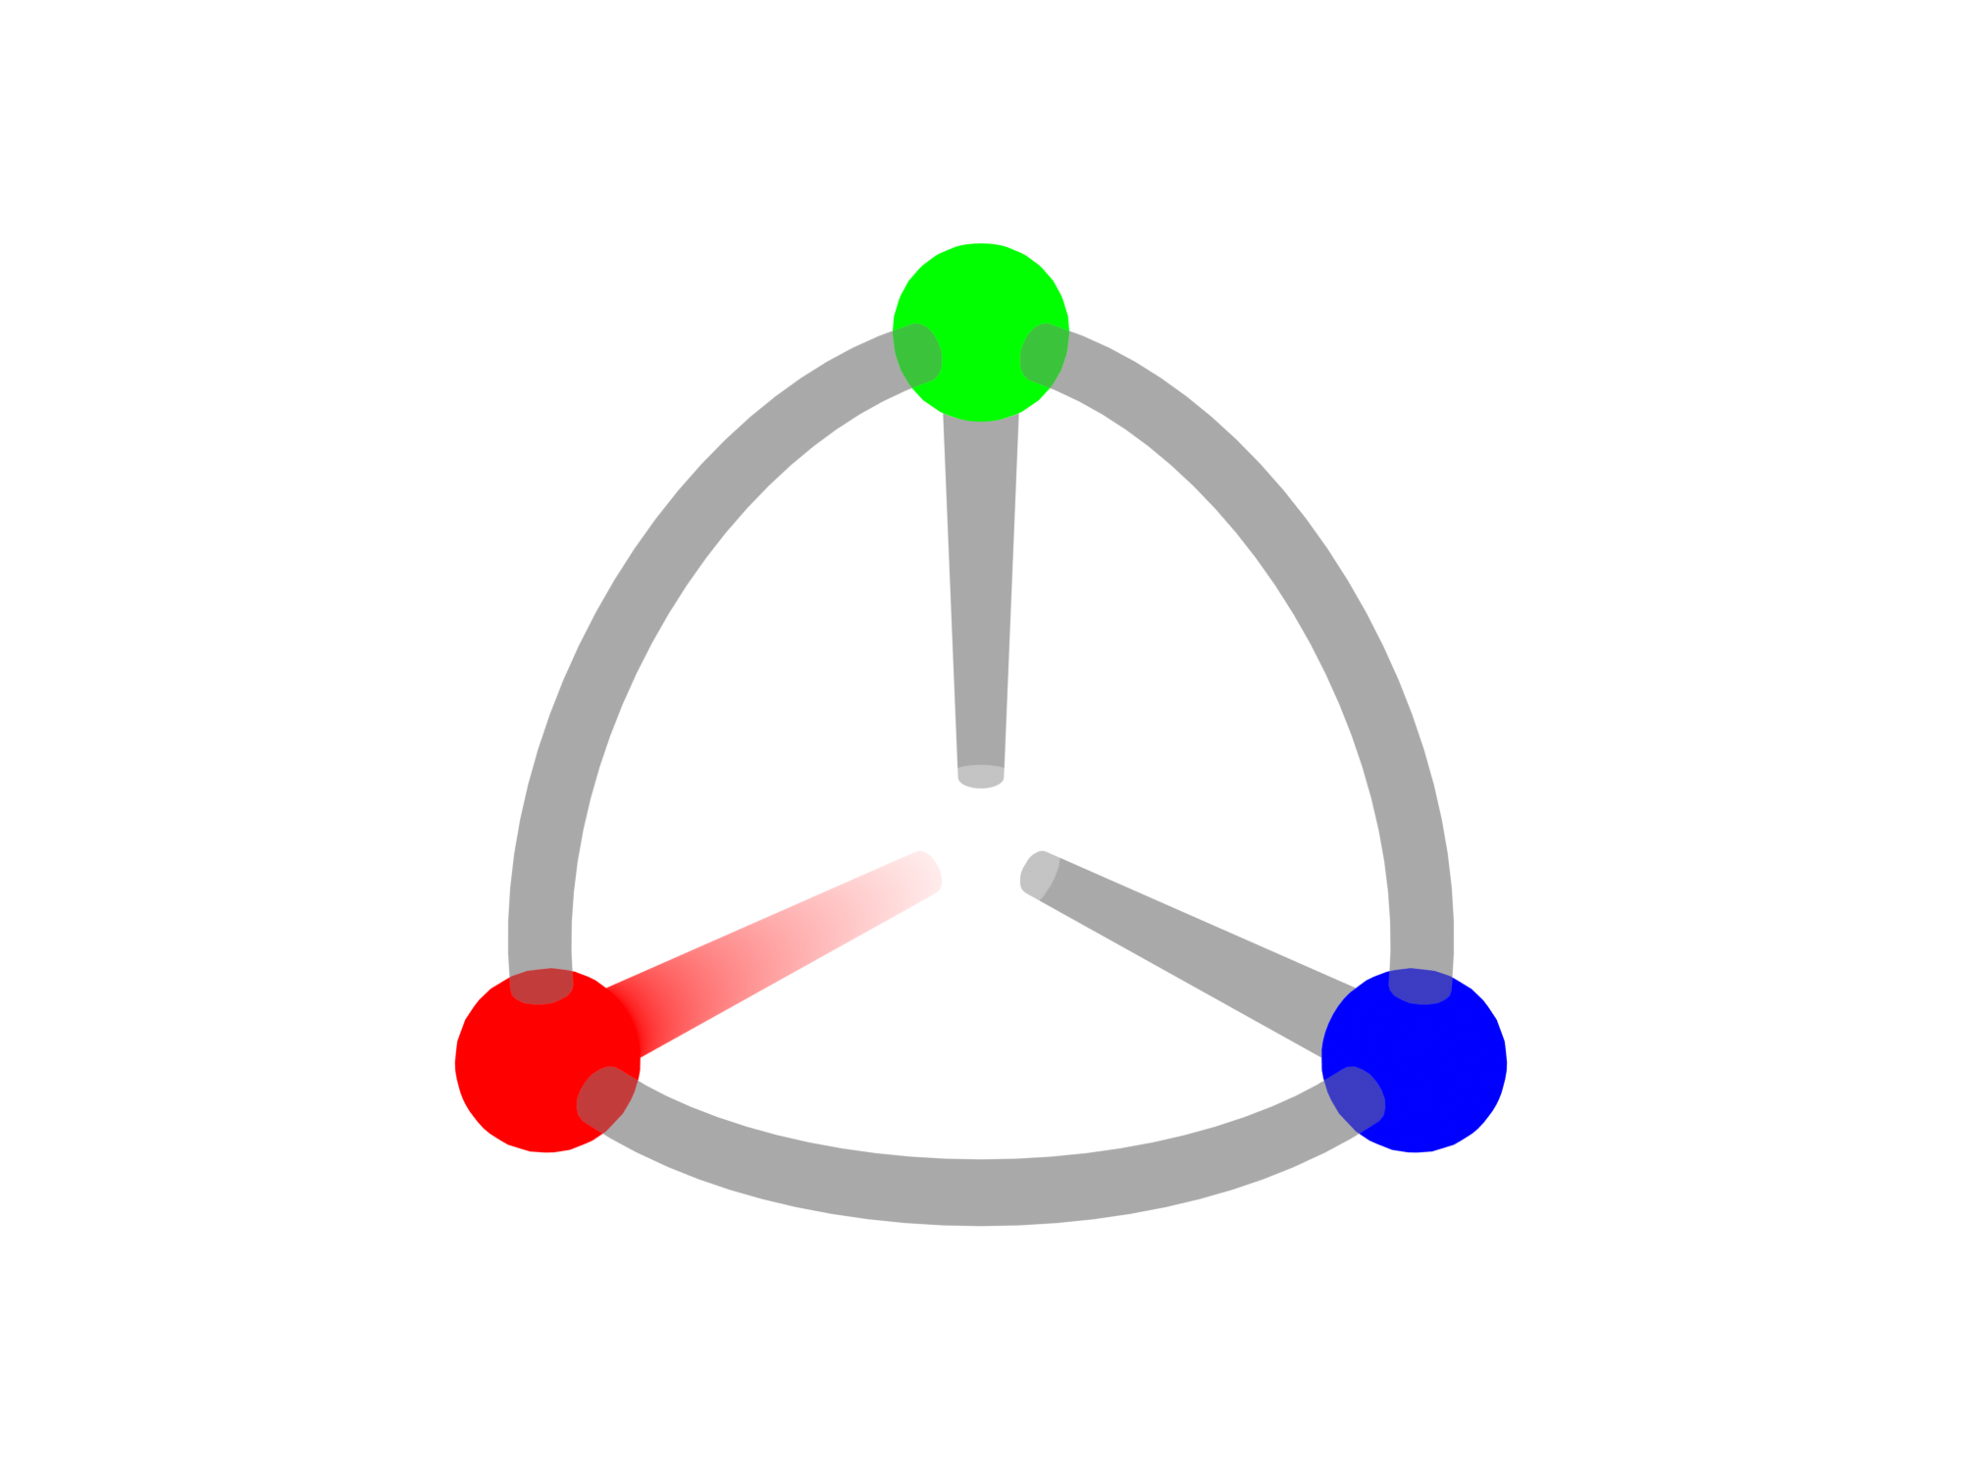
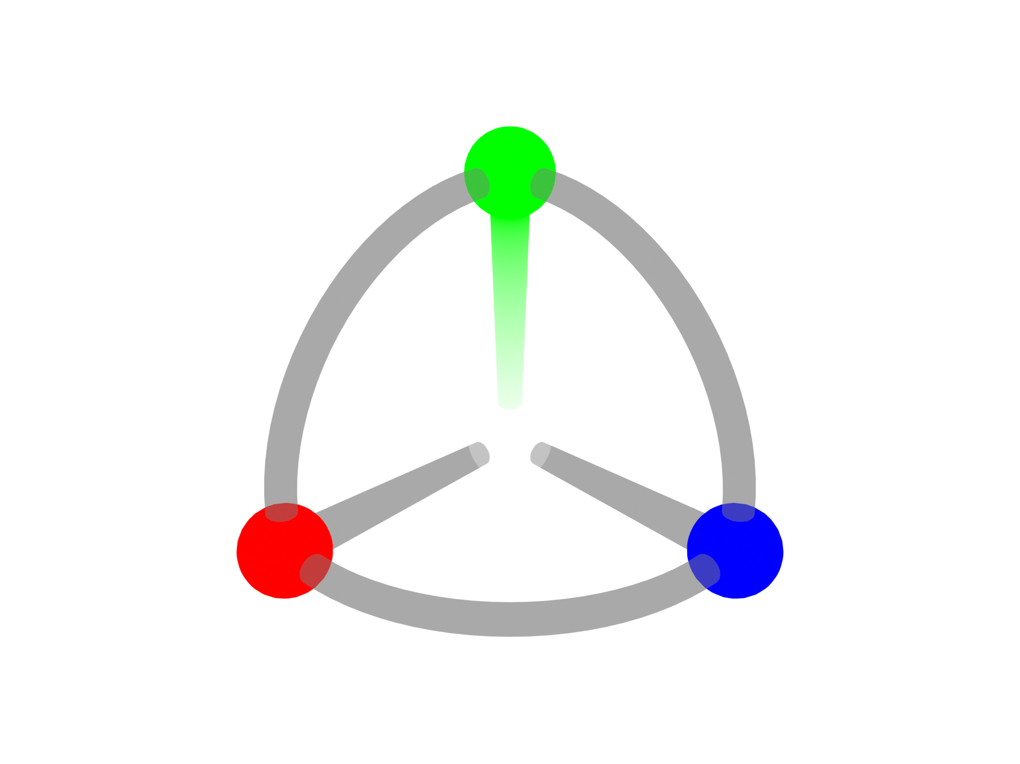
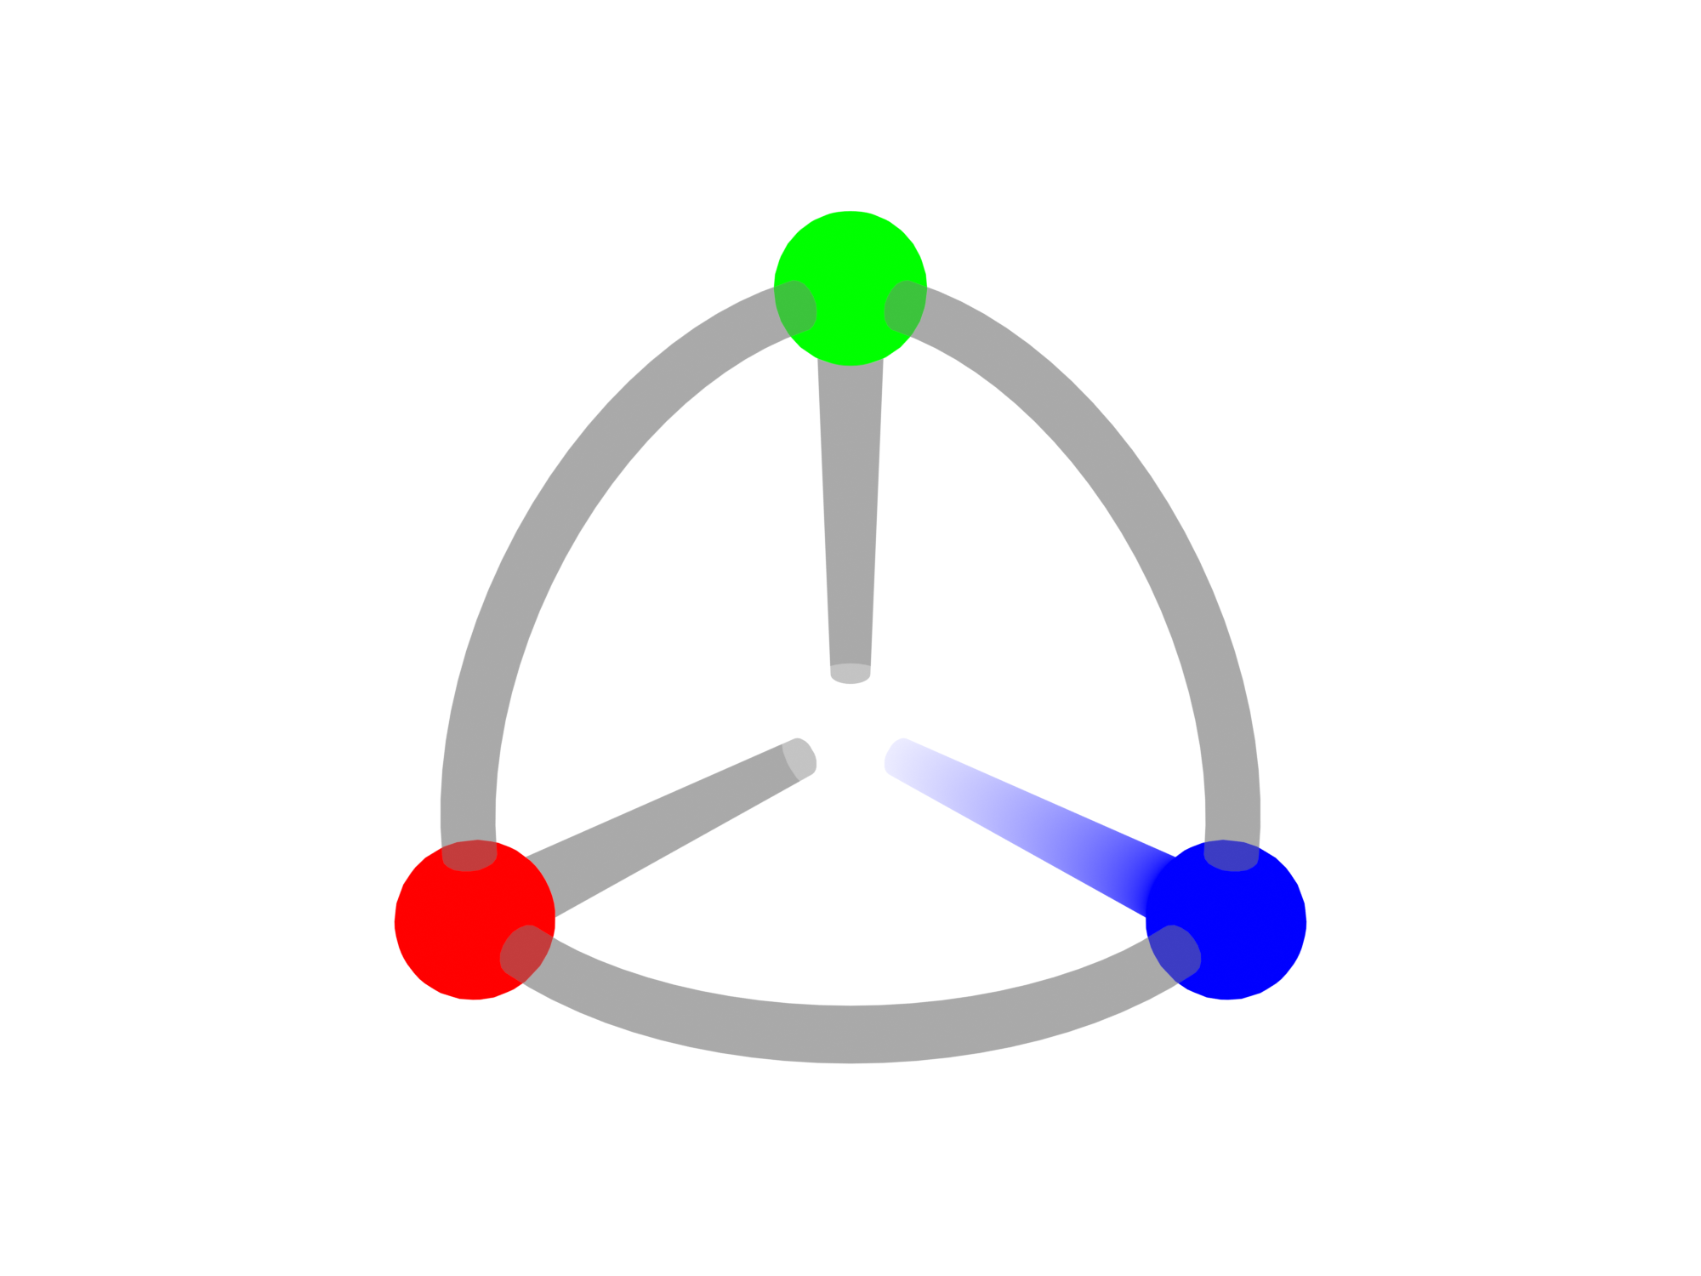
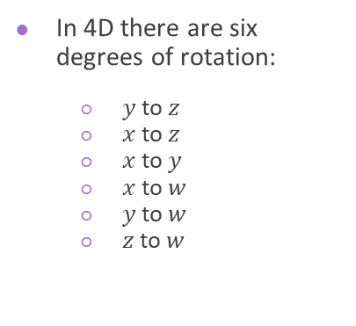
4D Rotation
In 4D there are six degrees of rotation:
$y$ to $z$
$x$ to $z$
$x$ to $y$
$x$ to $w$
$y$ to $w$
$z$ to $w$

Slide 8
Gimbal Lock
4D Rotation
Explain Gimbal Lock

Slide 9
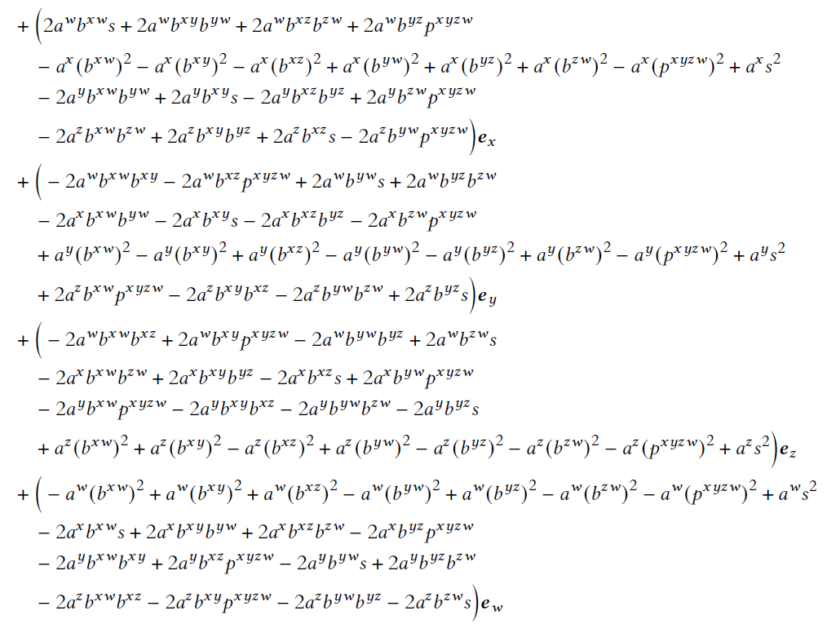
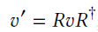
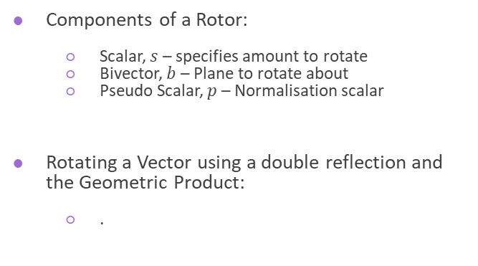
The Rotor
4D Rotation
Components of a Rotor:
Scalar, $s$ – specifies amount to rotate
Bivector, $b$ – Plane to rotate about
Pseudo Scalar, $p$ – Normalisation scalar
Rotating a Vector using a double reflection and the Geometric Product:
.

Slide 10
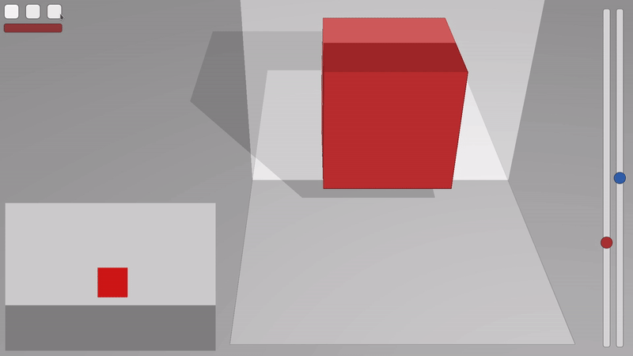
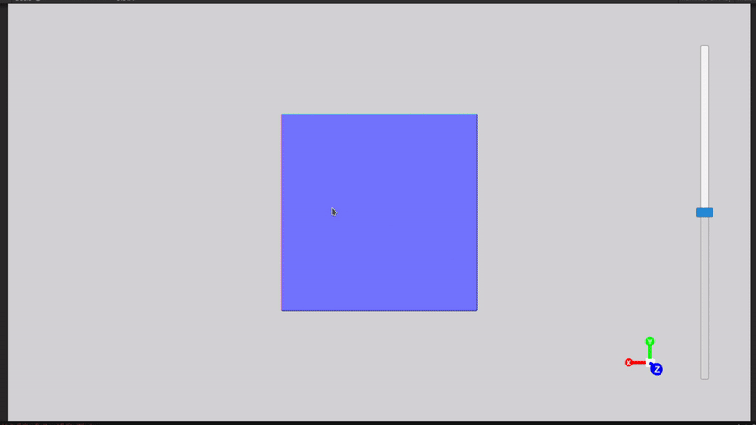

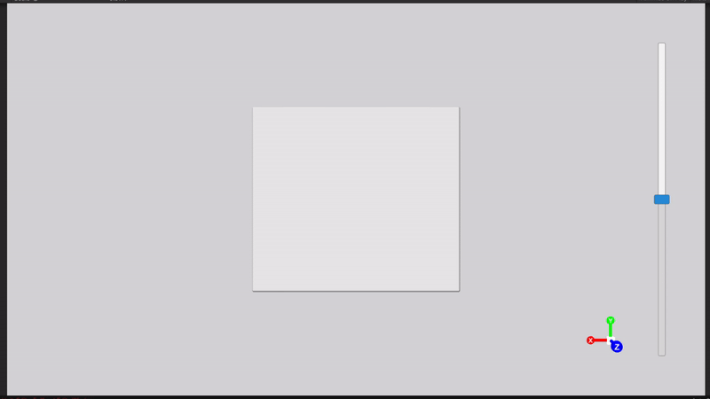
4D Rotation: 2D 3D 4D
2D Cross Section of 3D Object
3D Cross Section of 4D Object
Rotation within dimensions
Rotation outside of dimensions

Slide 11
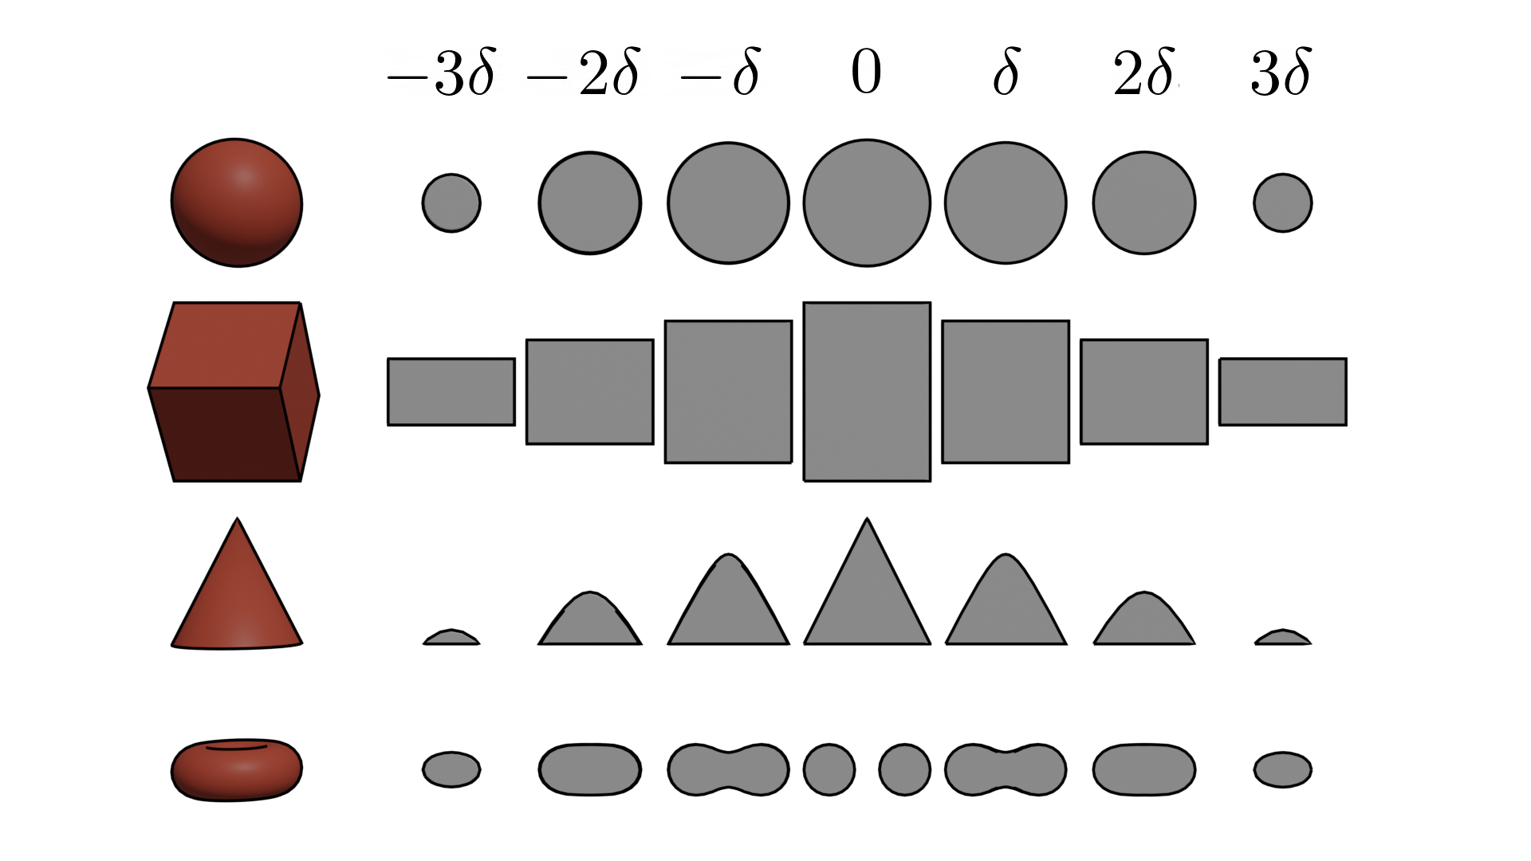
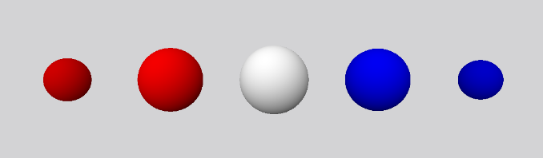
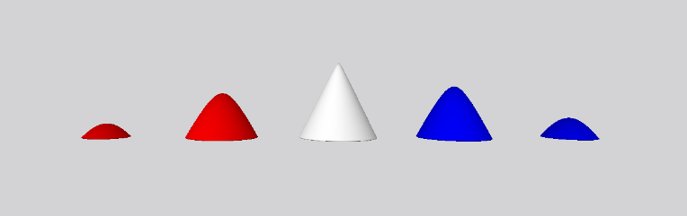
W-Axis “Timeline”
2D cross section of 3D Object $δ=0.15$ 3D cross section of 4D object $δ=0.2$
Extending a Cross Section of a 4D Object

Slide 12
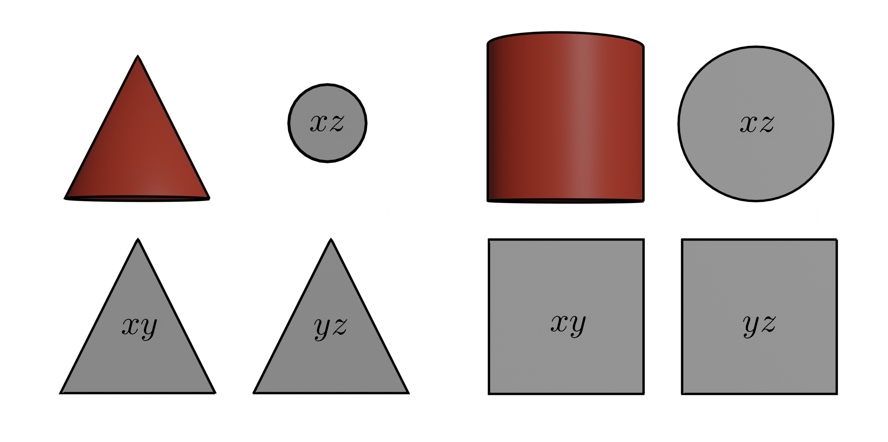
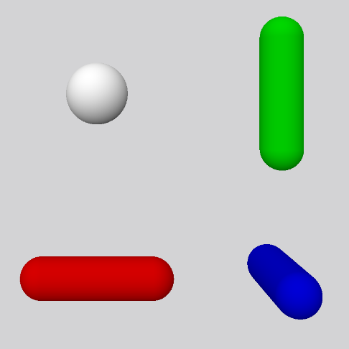
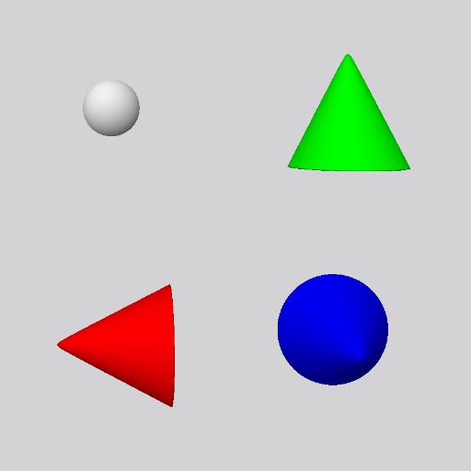
Multi-Rotational Views
Extending a Cross Section of a 4D Object

Slide 13
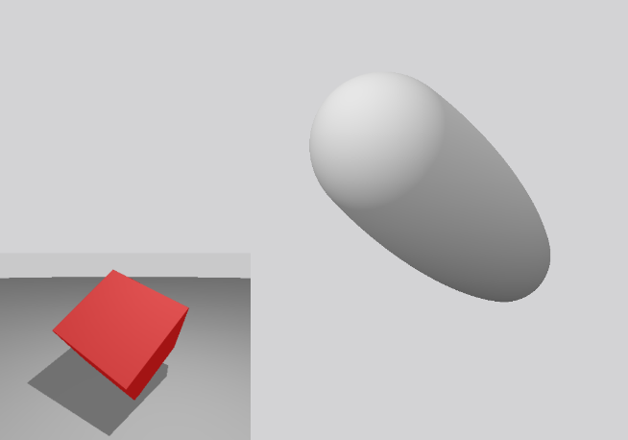
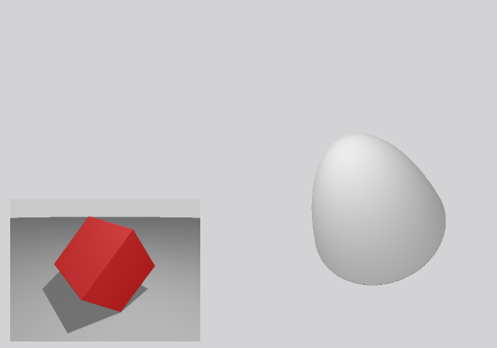
3D Axial Rotations on the 3D Component of a 4D Plane of Rotation
Extending a Cross Section of a 4D Object

Slide 14
Challenges
The Experiment
Challenging – time vs data
May have been too short for users

Slide 15
The van Hiele Model of Geometric Thinking
The Experiment
Stages in learning process
Needs people to understand

Slide 16
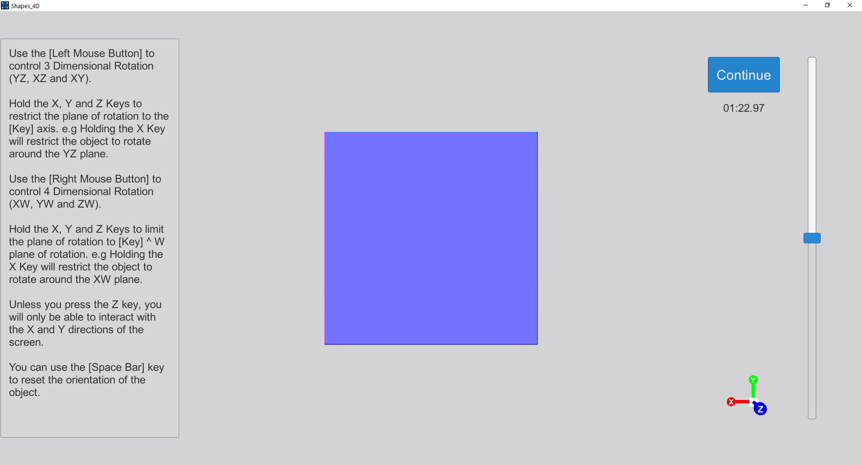
Introduction
The Experiment
Video
Small time to interact
Very much encourage questions

Slide 17
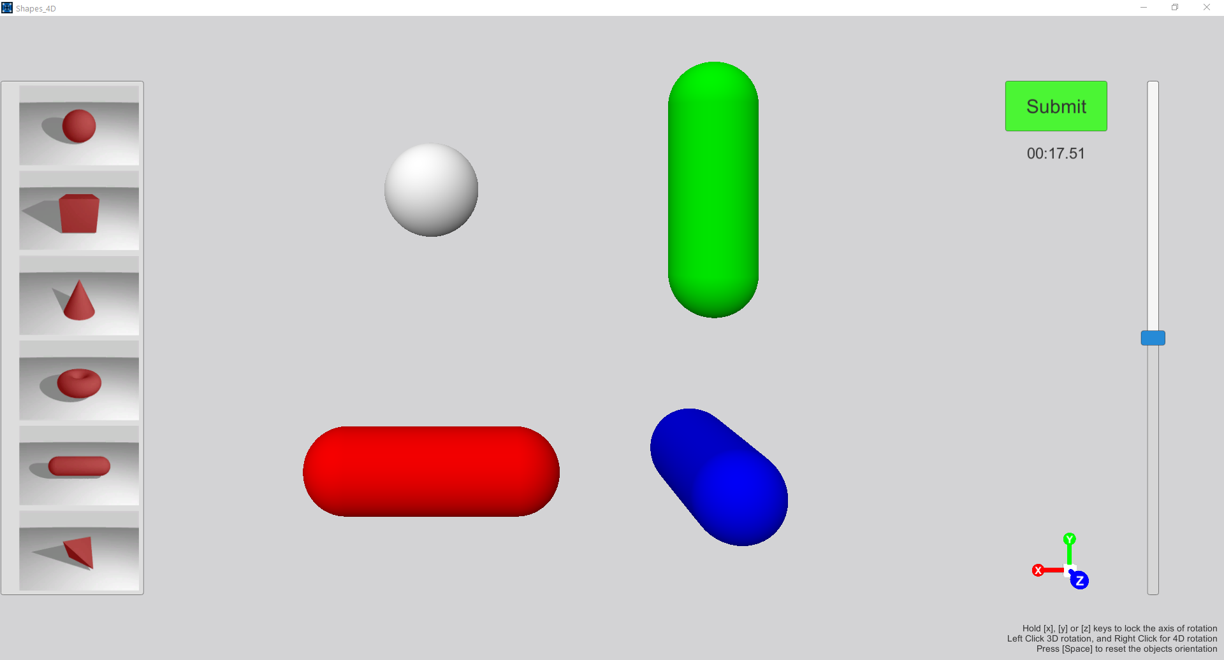
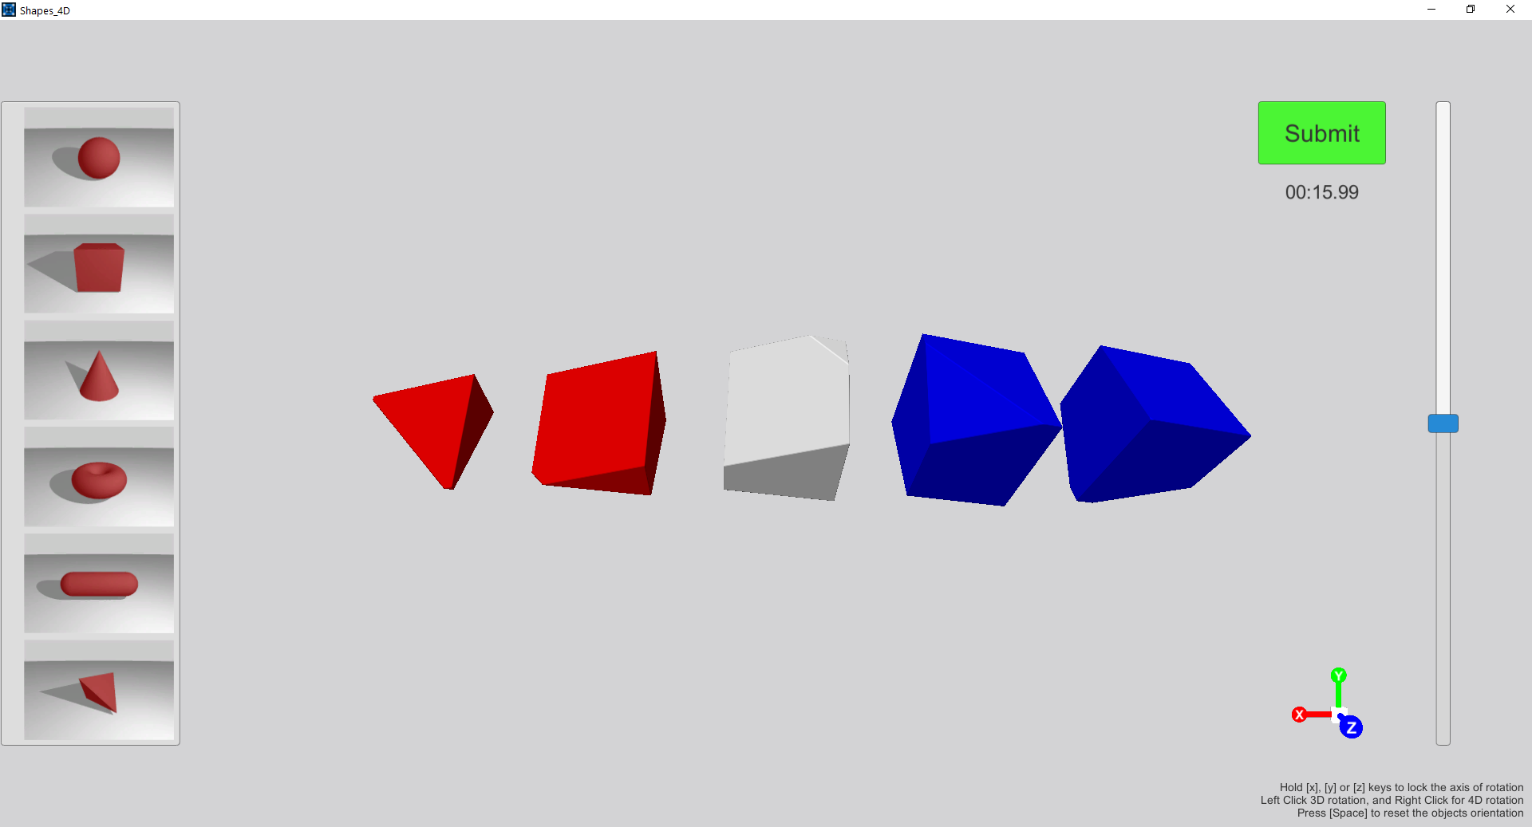
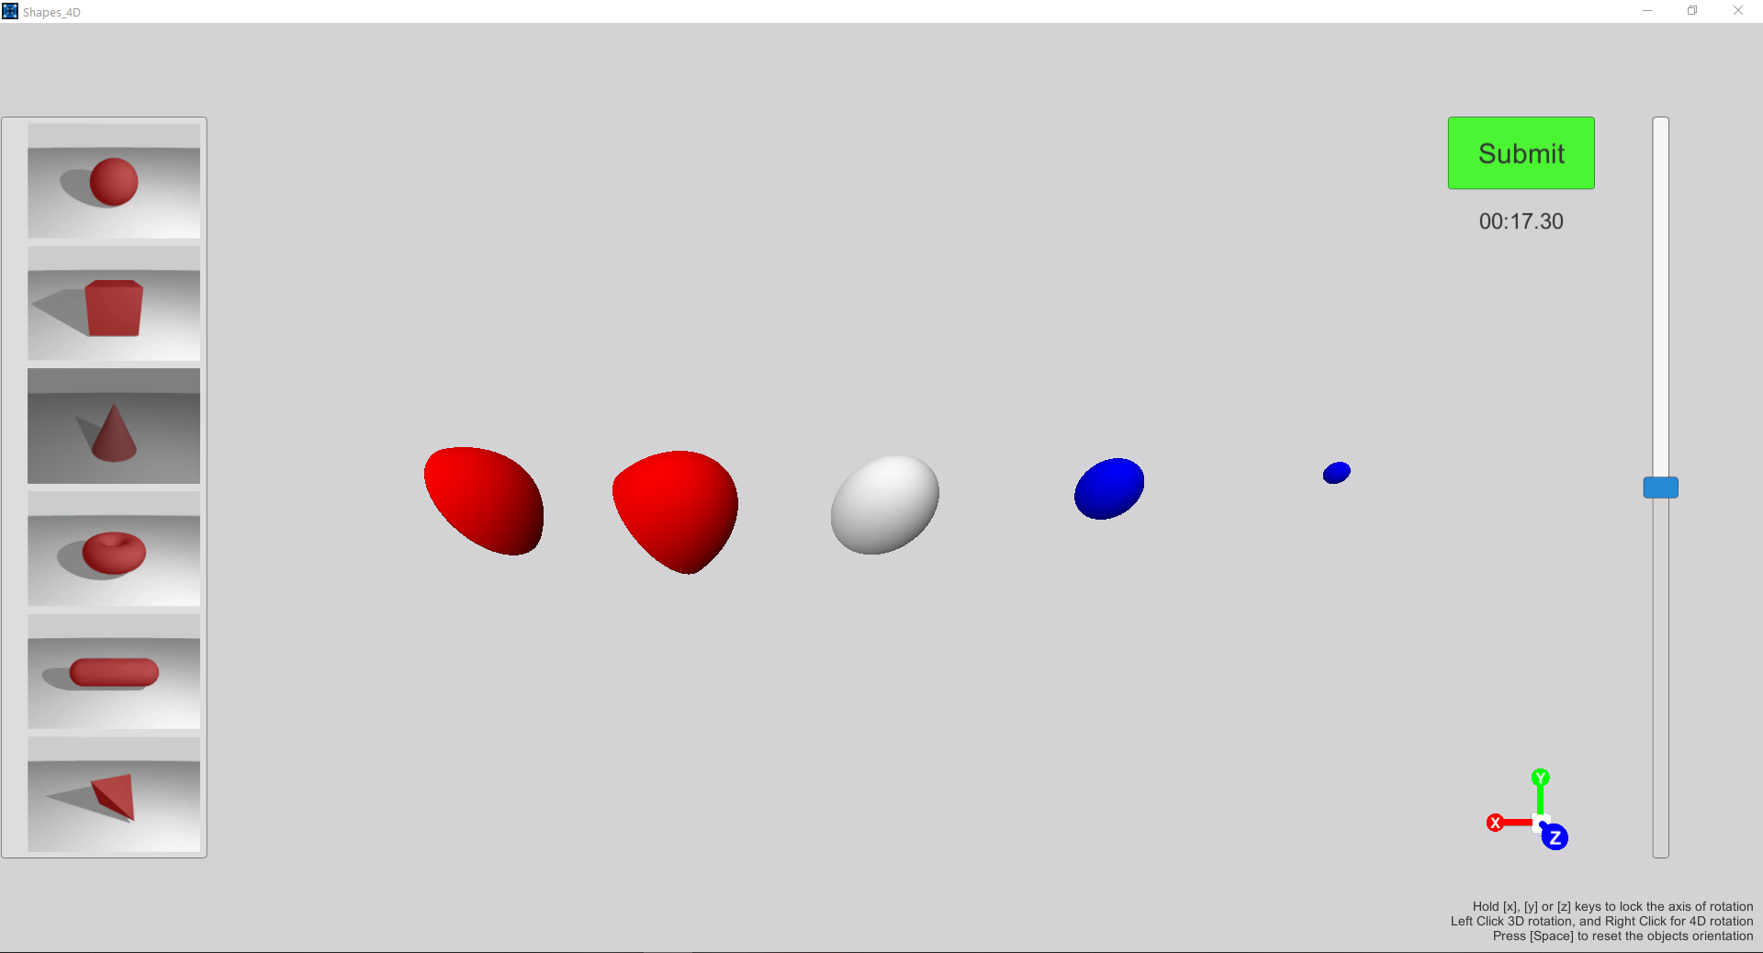
Shape Matching
The Experiment

Slide 18
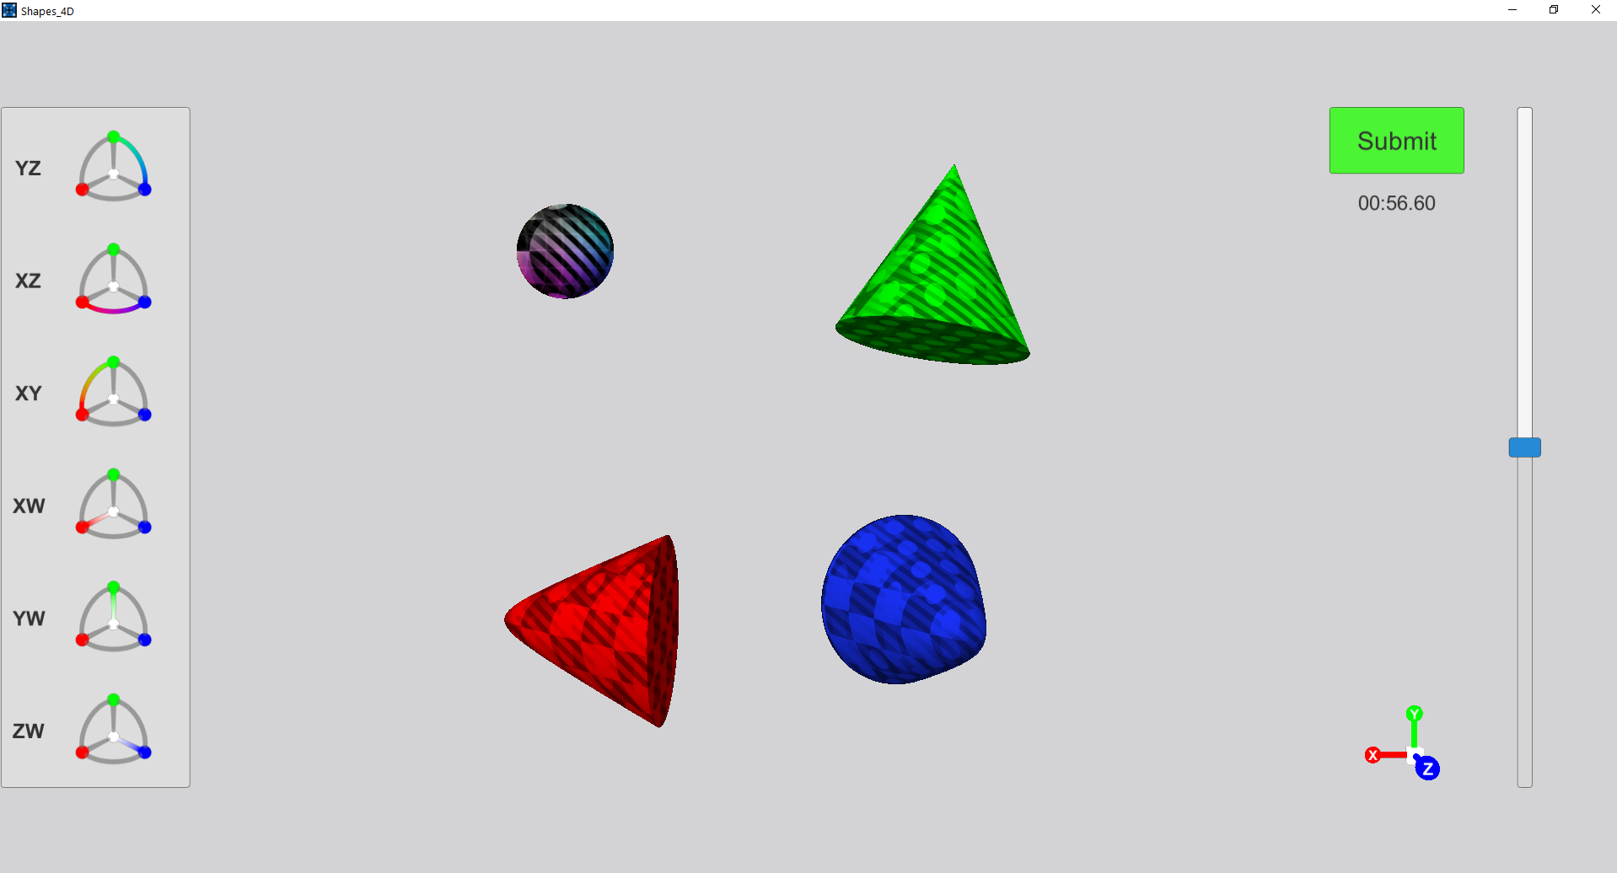
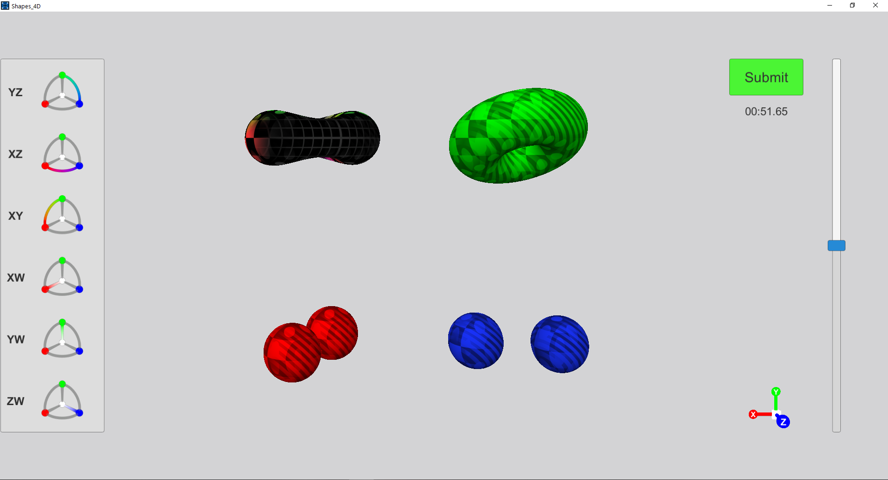
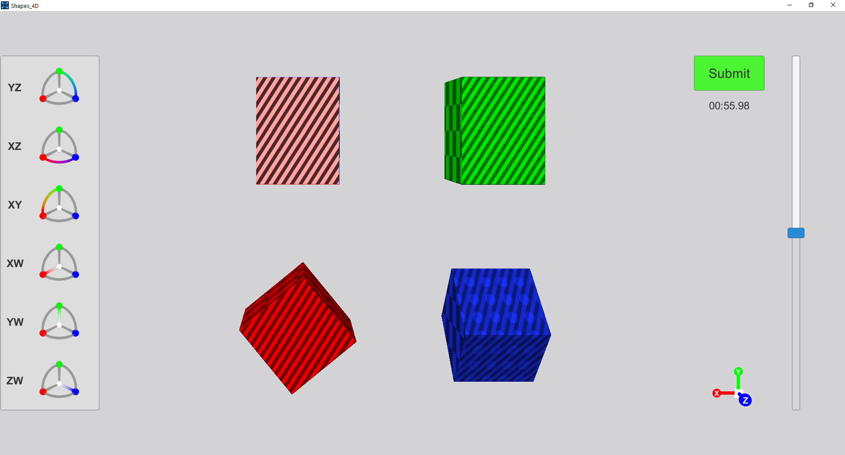
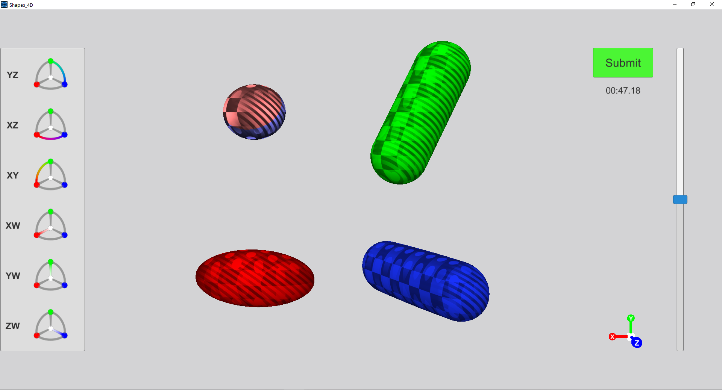
Rotation Matching
The Experiment

Slide 19
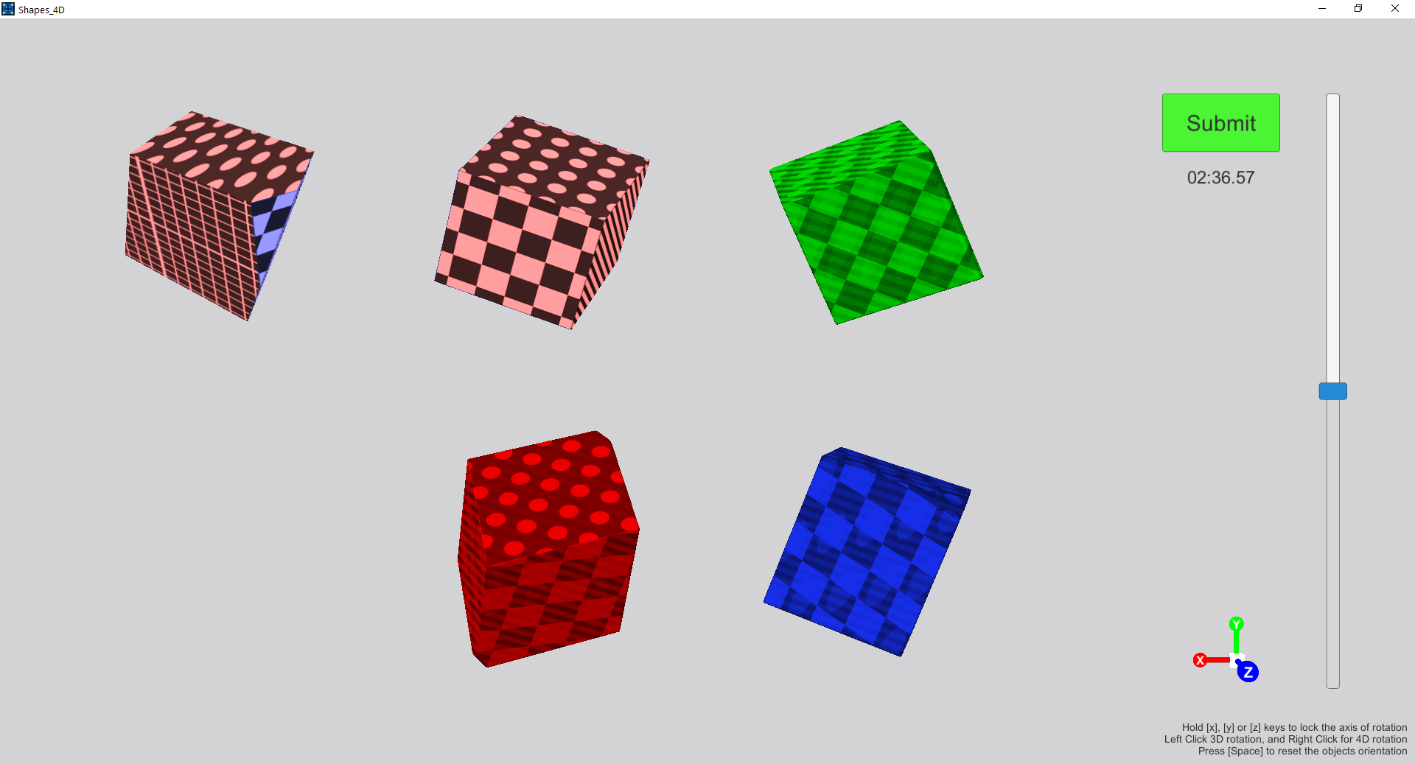
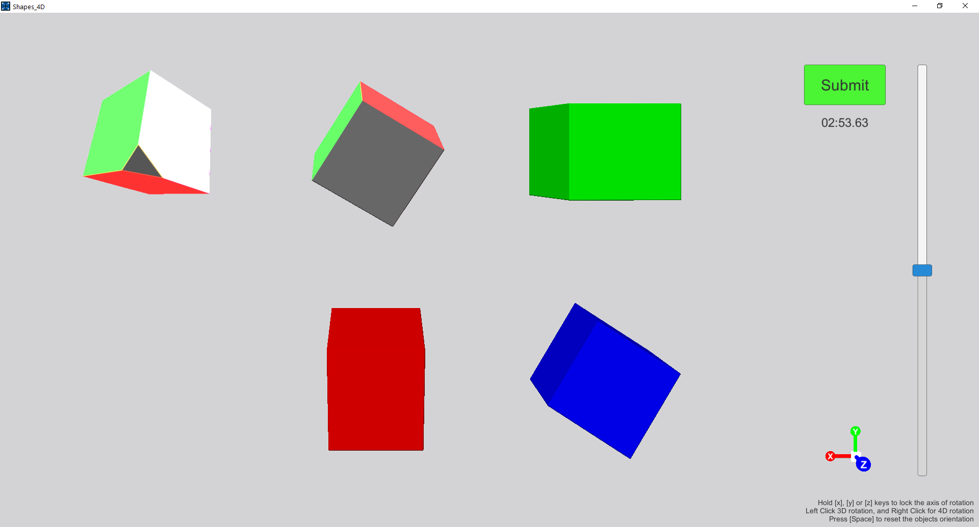
Pose Matching
The Experiment

Slide 20
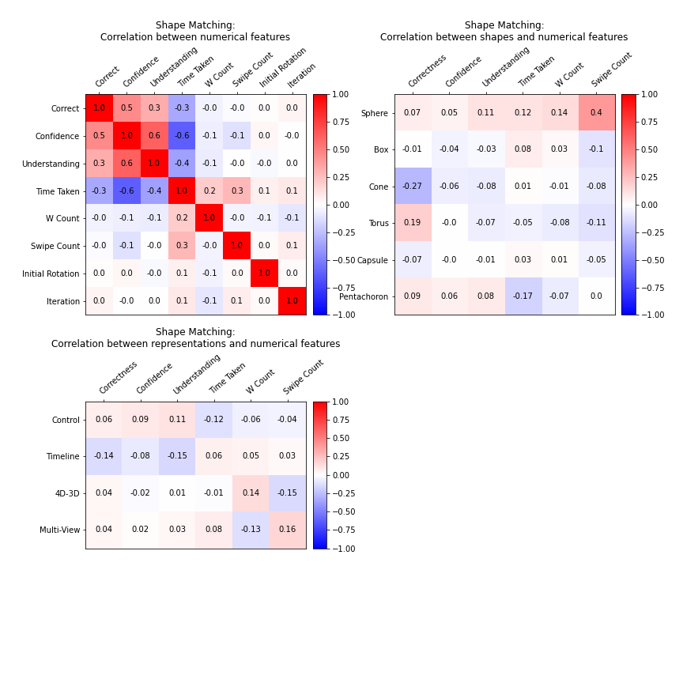
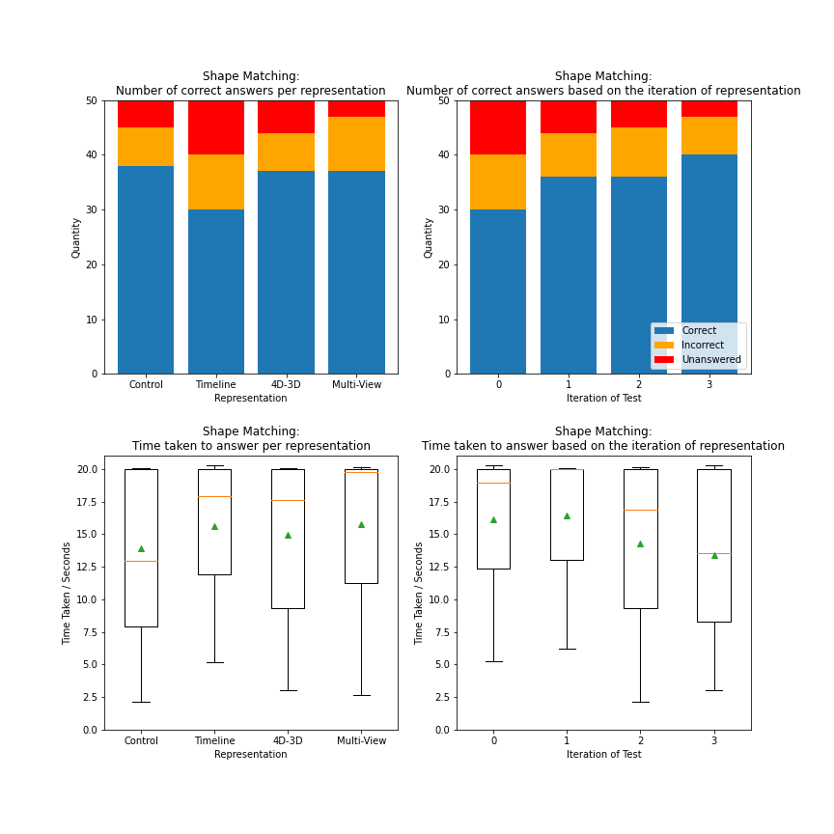
The Results
- Shape Matching

Slide 21
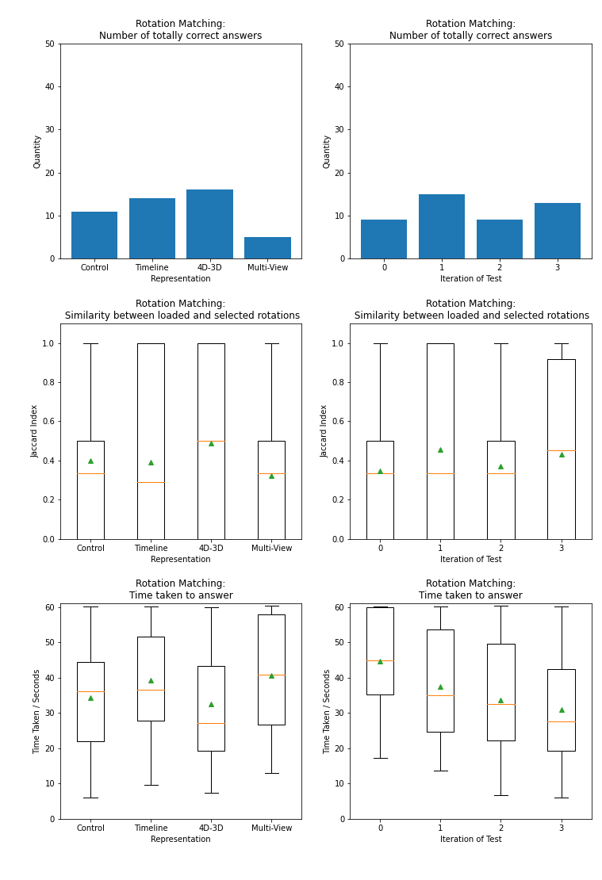
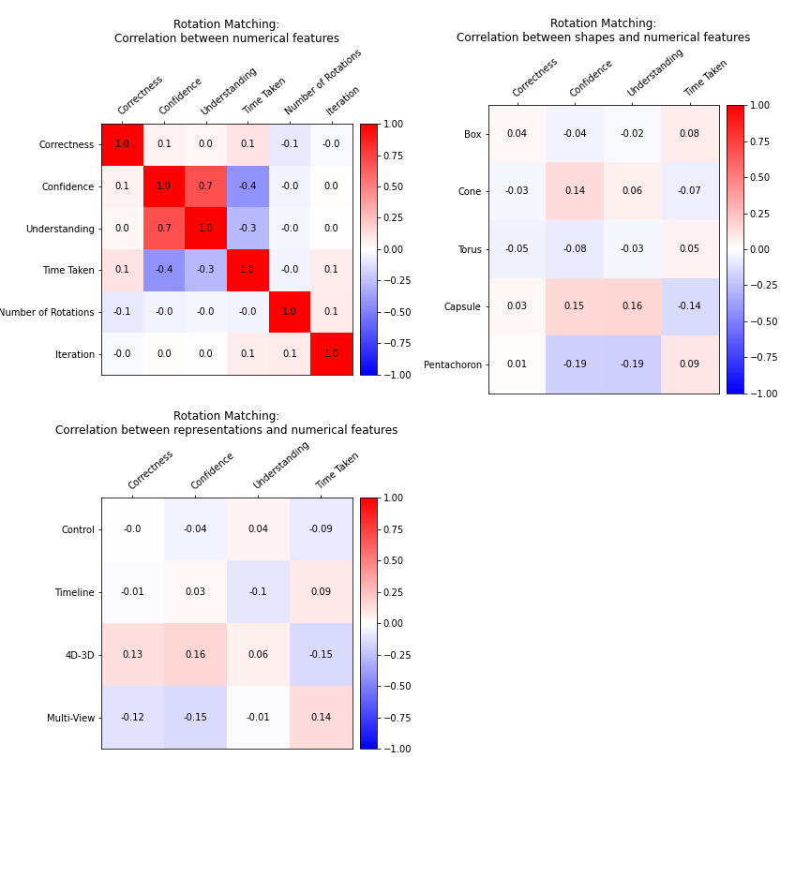
The Results
- Rotation Matching

Slide 22
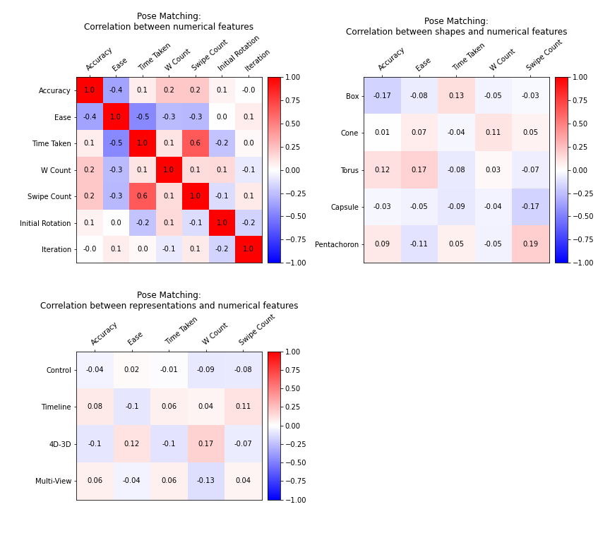
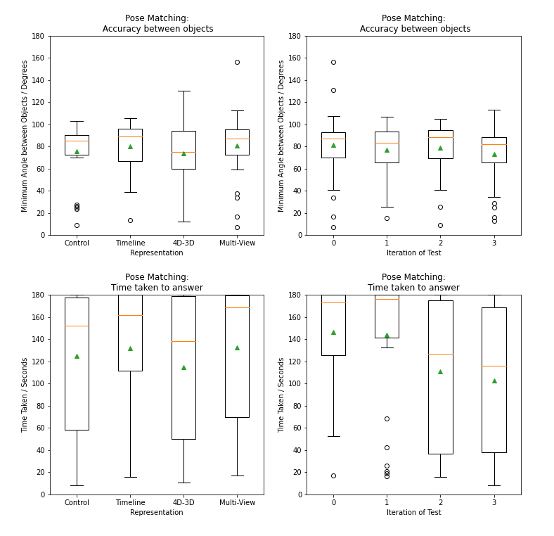
The Results
- Pose Matching

Slide 23
Summary
The Results

